Slide 1
Core Java CSIT751 (PG) (MODULE II : JAVA WITH OBJECT-ORIENTED FEATURES)

Slide 2
Topics Covered:
OOP Concepts
Classes and Objects
Encapsulation
Abstraction
Polymorphism (Overloading and Overriding)
Inheritance
Constructor
Abstract Class and Abstract Methods
Interface
Garbage Collection

Slide 3
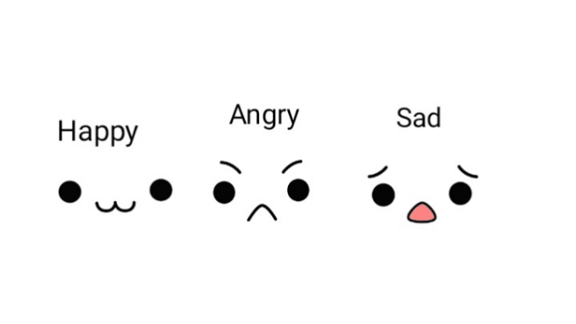
Class and Object
Objects are instances of classes, which serve as blueprints for creating objects.
Classes define the properties and behaviors of objects.

Slide 4

Class Declaration Syntax:
public class ClassName
{
// Fields (variables)
// Constructors
// Methods (functions)
}
Object Creation:
ClassName objectName = new ClassName();
Syntax
In Java, a class is declared using the 'class' keyword followed
by the class name.
Objects are created using the 'new' keyword followed by the
class name.

Slide 5
Fields and Methods
Fields are variables declared within a class to store data.
Methods are functions declared within a class to perform actions.

Slide 6


Example
Click here to see the Example

Slide 7
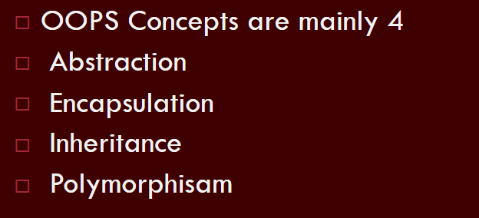
Object-Oriented Programming
Basic Concepts/Features

Slide 8
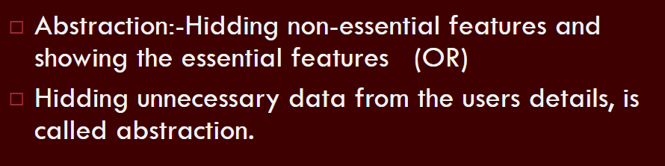
Basic Concepts – Abstraction

Slide 9
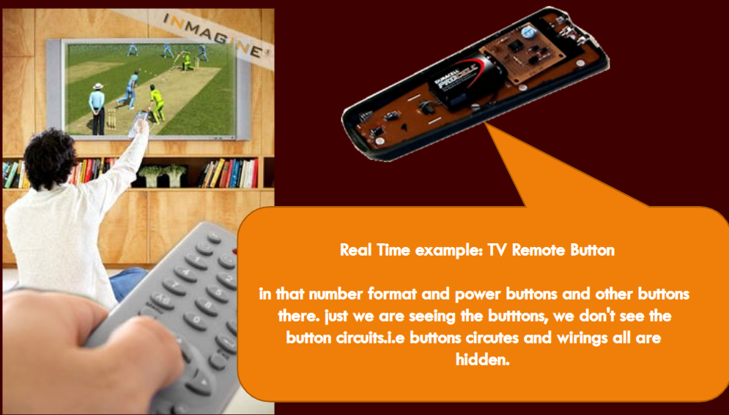
Abstraction Example

Slide 10
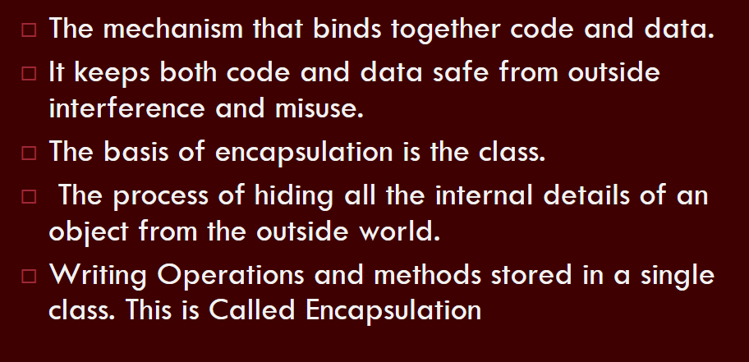
Basic Concepts – Encapsulation

Slide 11
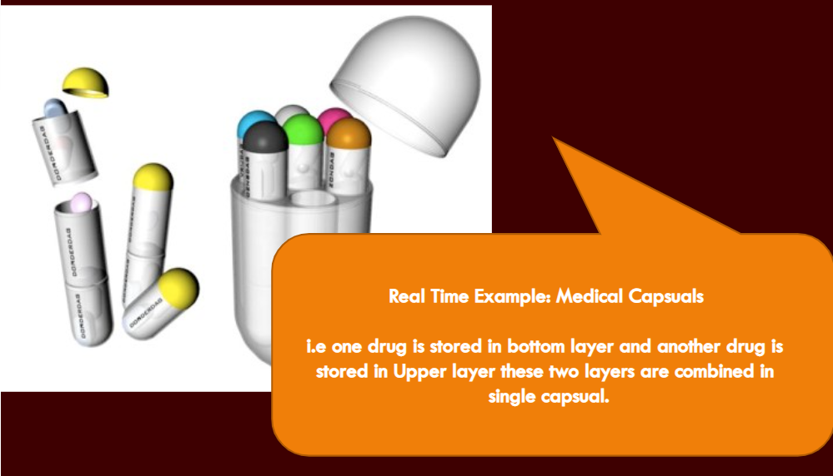
Encapsulation Example

Slide 12
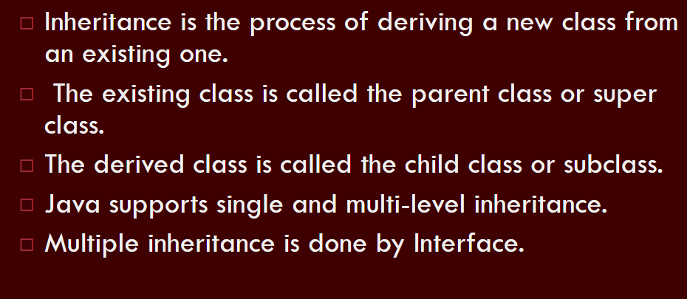
Basic Concepts – Inheritance

Slide 13
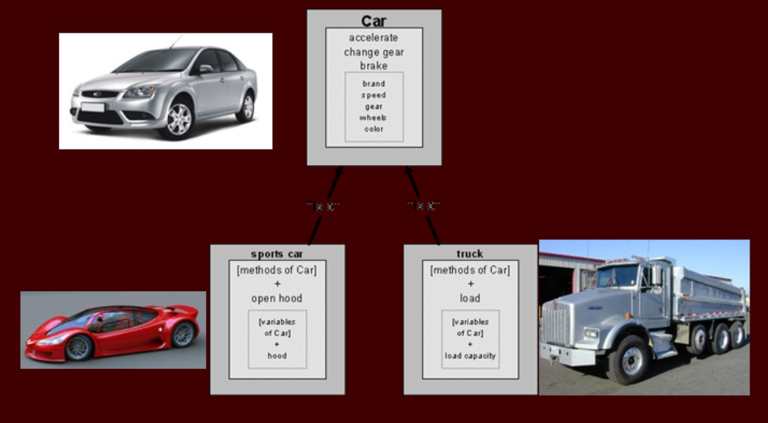
Inheritance Example

Slide 14
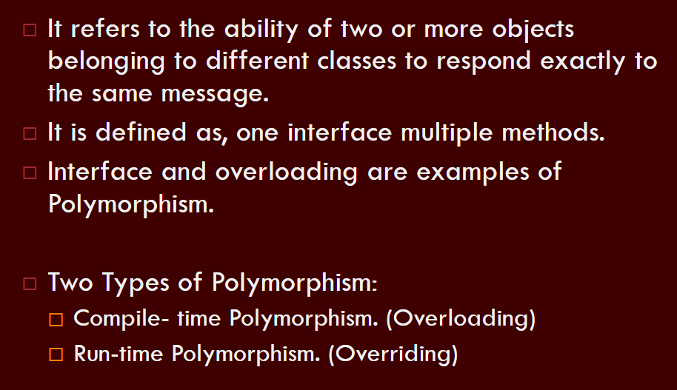
Basic Concepts – Polymorphism

Slide 15
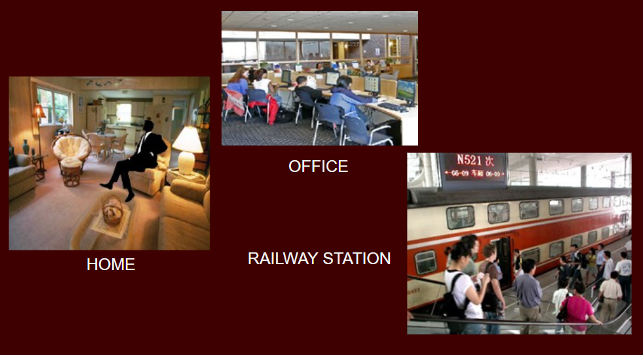
Polymorphism Example

Slide 16


Constructor : A Special Method of Class
Constructors are special methods used to initialize objects when they are created.
They have the same name as the class and do not have a return type.
Constructors are called implicitly when an object is created using the 'new' keyword.
A constructor in Java can not be abstract, final or static.

Slide 17
Types of constructor:
Default Constructor
No-Argument
Constructor
Parameterized
Constructor
Copy Constructor
A constructor that is
automatically created
by the Java compiler
Parameterized constructors
accept parameters to initialize
instance variables with
specific values.
A copy constructor
creates a new object
by copying the values
of another object.
A constructor that does
not accept any arguments

Slide 18
Examples
No-Argument Constructor
Parameterized Constructor
Copy Constructor

Slide 19
Constructor Overloading
Constructor overloading allows a class to have multiple constructors with different parameter lists.
It provides flexibility in object creation.

Slide 20
Inheritance
Inheritance allows us to derive a new class from an existing one
The existing class is called the parent class, or superclass, or base class
The derived class is called the child class or subclass.
As the name implies, the child inherits characteristics of the parent
That is, the child class inherits the methods and data defined for the parent class

Slide 21
Advantages using Inheritance
To fit a derived class, the programmer can add new variables or methods, or can modify the inherited ones
Software reuse is at the heart of inheritance
By using existing software components to create new ones, we capitalize on all the effort that went into the design, implementation, and testing of the existing software

Slide 22
Inheritance Types:
Single
Multilevel
Hierarchical
Using Interface, it is possible:
Hybrid
Multiple

Slide 23
Single Inheritance
Java supports single inheritance, meaning that a derived class can have only one parent class
Vehicle
Car

Slide 24
Deriving Subclasses
In Java, we use the reserved word extends to establish an inheritance relationship
class Car extends Vehicle
{
// class contents
}

Slide 25
Example
Single Inheritance Example

Slide 26
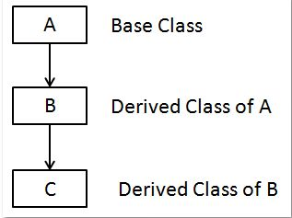
Multilevel Inheritance
Multilevel inheritance is where a class inherits from another class, which in turn inherits from yet another class, forming a chain
This creates a "grandparent-parent-child" relationship among classes.
Multilevel Inheritance
Example

Slide 27
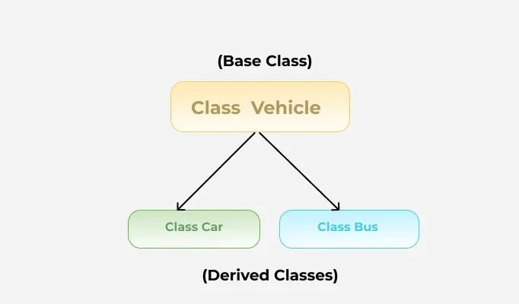
Hierarchical Inheritance
In hierarchical inheritance, more than one subclass is inherited from a single base class. i.e. more than one derived class is created from a single base class.
For example, cars and buses both are vehicle
Hierarchical Inheritance
Example

Slide 28
The protected Modifier
Visibility modifiers determine which class members are inherited and which are not
The protected modifier allows a member of a base class to be inherited into a child
Access Modifier | within class | within package | outside package by subclass only | outside package
Private | Y | N | N | N
Default | Y | Y | N | N
Protected | Y | Y | Y | N
Public | Y | Y | Y | Y

Slide 29
Method Overriding
A child class can override the definition of an inherited method in favor of its own
The new method must have the same signature as the parent's method, but can have a different body
The type of the object executing the method determines which version of the method is invoked

Slide 30
Rules of Overriding
Name, parameters, and return type must match the parent method.
Java picks which method to run, based on the actual object type, not just the variable type.
Static methods cannot be overridden.
The @Override annotation catches mistakes like typos in method names.
Method Overriding Example

Slide 31
The super keyword
Constructors are not inherited, even though they have public visibility
The super keyword can be used to refer to the parent class, and often is used to invoke the parent's constructor
A child’s constructor is responsible for calling the parent’s constructor
The first line of a child’s constructor should use the super keyword to call the parent’s constructor
The super keyword can also be used to reference other variables and methods defined in the parent’s class

Slide 32
Example: Role of Constructor in Inheritance using Super
Super keyword Example

Slide 33
The final keyword
In Java, the final keyword can be applied to classes, methods, and variables to prevent inheritance, method overriding, and variable reassignment, respectively.
final class FinalClass {
// Contents of the final class
}
// Attempting to extend a final class will result in a compilation error.
// class SubClass extends FinalClass { }

Slide 34
When applied to a method, the final keyword prevents the method from being overridden in subclasses.
Here's an example:
class Parent {
final void display() {
System.out.println("This is a final method.");
}
}
class Child extends Parent {
// Attempting to override the final method will result in a compilation error.
// void display() { }
}

Slide 35
Use of super/final in Overriding
A parent method can be invoked explicitly using the super reference
If a method is declared with the final modifier, it cannot be overridden.

Slide 36
Abstract Class and Interface
abstract method
and abstract class
interfaces, static and default
methods

Slide 37
Abstract Class
An abstract class is a class that cannot be instantiated on its own; it serves as a template for other classes to inherit from.
It may contain both abstract and non-abstract methods.
Abstract methods are methods without a body that subclasses must implement.
Non-abstract or concrete methods are methods with a body that can be inherited by subclasses.

Slide 38
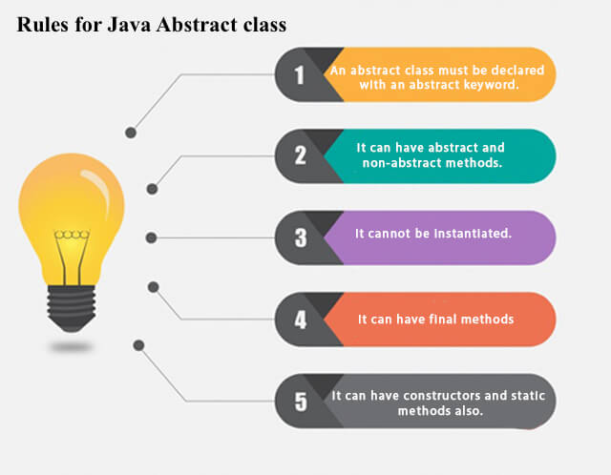
Abstract Class

Slide 39
Example
Abstract Class Example

Slide 40
Abstract Method
A method which is declared as abstract and does not have implementation is known as an abstract method
Example of Abstract Method
abstract void printStatus();
//no method body and that’s why abstract

Slide 41
Interfaces
An interface is a collection of abstract methods. A class implements an interface, thereby inheriting the abstract methods of the interface.
An interface is not a class. Writing an interface is similar to writing a class, but they are two different concepts. A class describes the attributes and behaviors of an object. An interface contains behaviors that a class implements.

Slide 42
Similarity between Interface & class
An interface is similar to a class in the following ways:
An interface can contain any number of methods.
An interface is written in a file with a .java extension, with the name of the interface matching the name of the file.
The bytecode of an interface appears in a .class file.

Slide 43
Difference between interface & class
An interface is different from a class in several ways, including:
You cannot instantiate an interface.
An interface does not contain any constructors.
All of the methods in an interface are abstract.
An interface cannot contain instance fields. The only fields that can appear in an interface must be declared both static and final.
An interface is not extended by a class; it is implemented by a class.
An interface can extend multiple interfaces.

Slide 44
Properties of INTERFACES
Interfaces have the following properties:
An interface is implicitly abstract. You do not need to use the abstract keyword when declaring an interface.
Each method in an interface is also implicitly abstract, so the abstract keyword is not needed.
Methods in an interface are implicitly public.

Slide 45
Syntax for declaring interfaces
interface InterfaceName
{
variables declaration;
methods declaration;
}

Slide 46
Extending interfaces
An interface can be sub-interfaced from other interfaces.
interface name2 extends name1
{
body of name2
}

Slide 47
Extending interfaces
// Parent interface
interface Animal {
void eat();
}
// Child interface extending parent
interface Dog extends Animal {
void bark();
}

Slide 48
Implementing interfaces
Interfaces are used as super classes whose properties are inherited by classes.
class classname implements interfacename
{
body of classname
}

Slide 49
Example
Implement Interface Example

Slide 50
Interface Supports Multiple Inheritance
✅ Java does not allow multiple inheritance with classes (to avoid diamond problem).
✅ Interfaces can extend multiple interfaces (e.g., interface C extends A, B).
✅ A class can implement multiple interfaces, gaining behaviors from all.
✅ This provides a form of multiple inheritance of type without ambiguity.
✅ If two interfaces have methods with the same signature → only one implementation is required.

Slide 51
Example
Multiple Inheritance Example

Slide 52
Default method in Interface
Java provides a facility to create default methods inside the interface. Methods which are defined inside the interface and tagged with default are known as default methods. These methods are non-abstract methods.
Default methods enable you to add new functionality to the interfaces of your libraries and ensure binary compatibility with code written for older versions of those interfaces.

Slide 53
Example
Default method interface Example

Slide 54
Static methods in Interface
A static method is a method that is associated with the class in which it is defined rather than with any object. Every instance of the class shares its static methods.
You can also define static methods inside the interface. Static methods are used to define utility methods.
Static method in interface are part of the interface, class can’t implement or override it

Slide 55
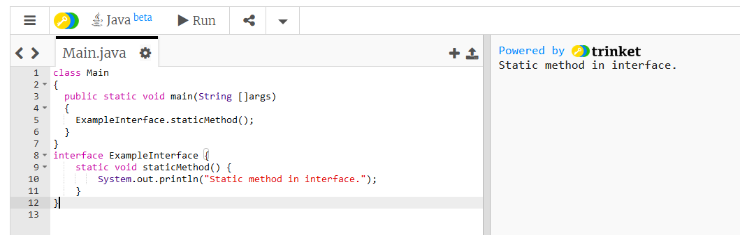
Example:
Static methods in interfaces can be called using the interface name, without needing an instance of a class that implements the interface.

Slide 56
Garbage Collection
Java has automatic memory management → no need to manually free memory (like free() in C/C++).
Garbage Collector (GC) reclaims memory from objects that are no longer reachable.
Objects become eligible for GC when no reference points to them.
Prevents memory leaks by cleaning unused objects.
You can suggest GC with System.gc(), but JVM decides when to run it.

Slide 57
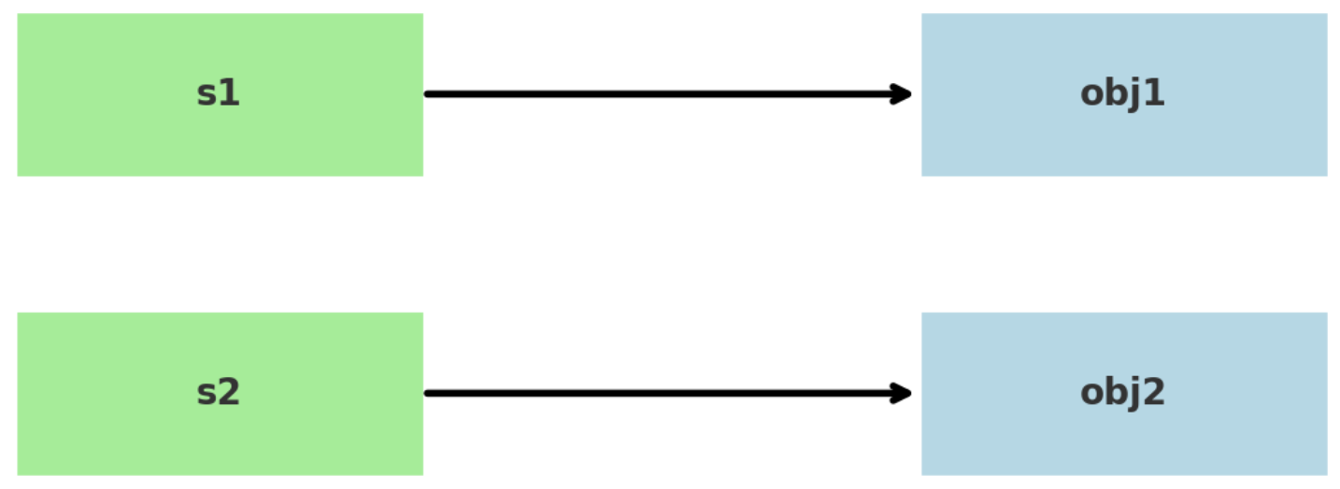

Garbage Collection
Initially s1 was pointing to obj1 ("Hello") but after s1 = null;, no variable references it anymore → so it becomes eligible for Garbage Collection.

Slide 58
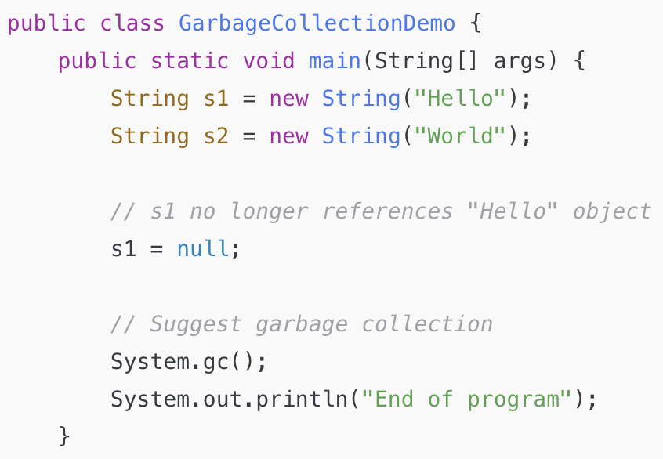
Garbage Collection

